Slide 1

CASE STUDY MAVERICK BANK
PRESENTED BY
SANIKA SAVALAJKAR

Slide 2

Introduction
A role-based digital banking system.
Roles: Customer, Bank Employee, Administrator
Implements core banking features like:
User registration, login, and role-based authorization.
Account management, secure transactions, and reporting.
Uses RESTful architecture and layered Spring Boot application design.

Slide 3

Project Goals
Create a modular, maintainable, and scalable backend banking system.
Provide secure REST APIs for Customer, Employee, Admin roles.
Use best practices like DTOs, service abstraction, entity-repository layers.

Slide 4

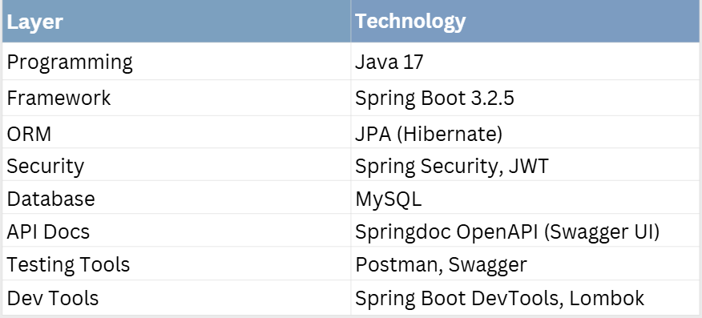
Technology Stack

Slide 5
Architecture
Controller: Handles REST APIs.
Service Layer: Business logic.
Repository: JPA interface to DB.
DTOs: Data Transfer Objects for abstraction.
Entities: DB mapped objects.

Slide 6
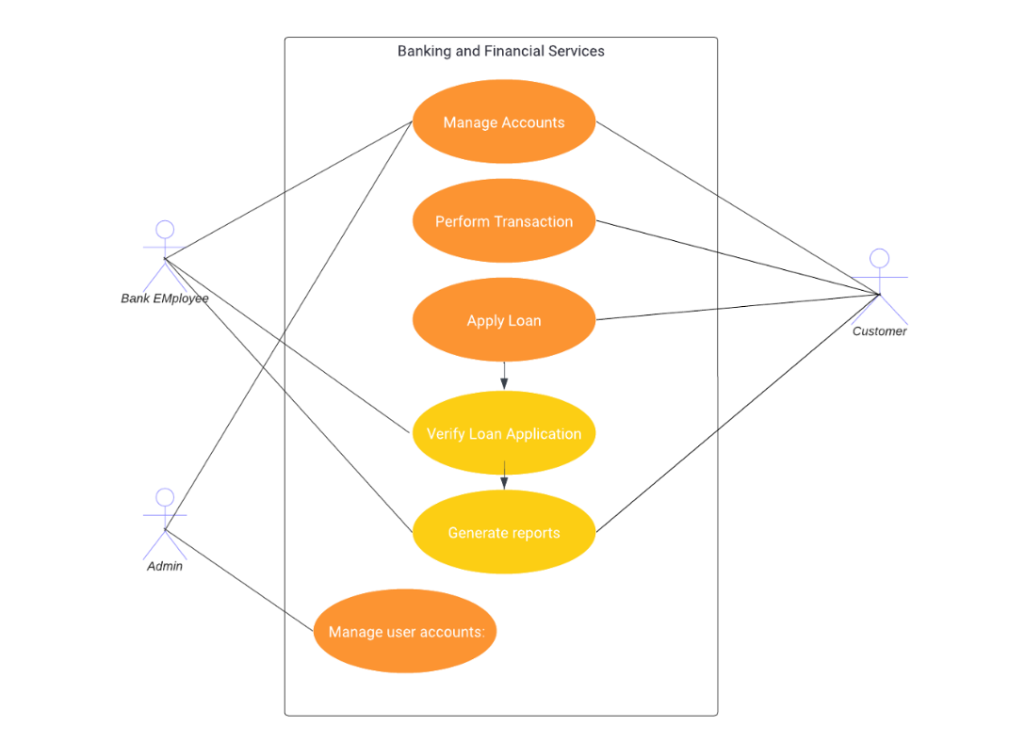
Diagram

Slide 7
Roles
Customer:
Register/Login, Open Account, Deposit, Withdraw, Transfer.
Bank Employee:
Approve accounts, manage customers, review transactions.
Admin:
Manage employee records and user access levels.

Slide 8
Technology Stack
IMPLEMENTED USE CASES:
User Registration and Login
CRUD for Accounts, Customers, Bank Employees
Role-based transactions
Transaction history
Customer-Employee linking
Swagger-based API testing

Slide 9
Database Design
User Table
PK: userId, FK: roleId
Role Table
roleId, name (CUSTOMER, BANK_EMPLOYEE, ADMIN)
Customer
Linked to User
BankEmployee
Linked to User, Branch
Account
Linked to Customer, Branch
Transaction
Linked to Account

Slide 10
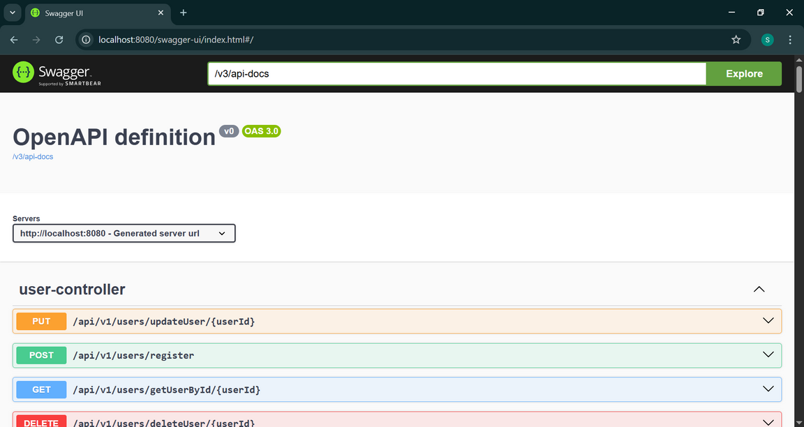
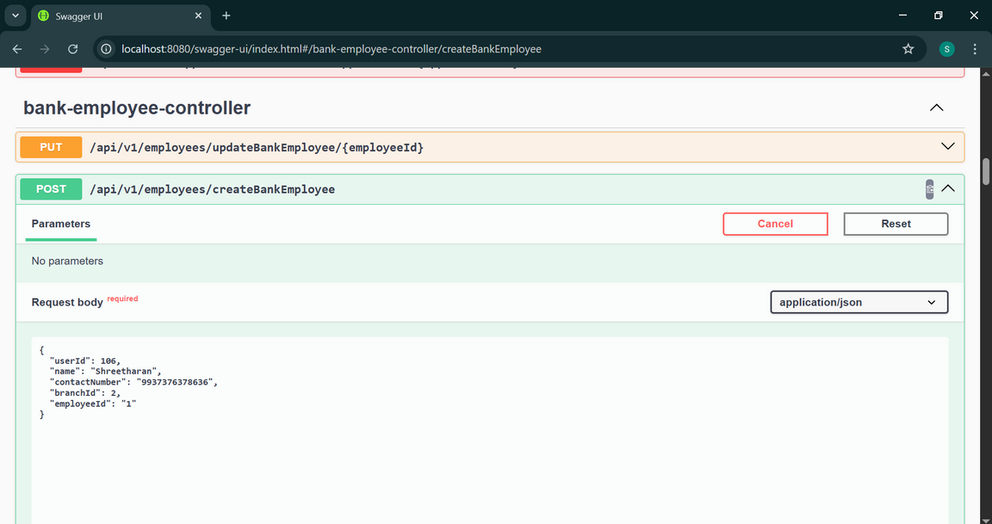
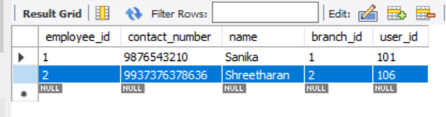
Swagger Output

Slide 11
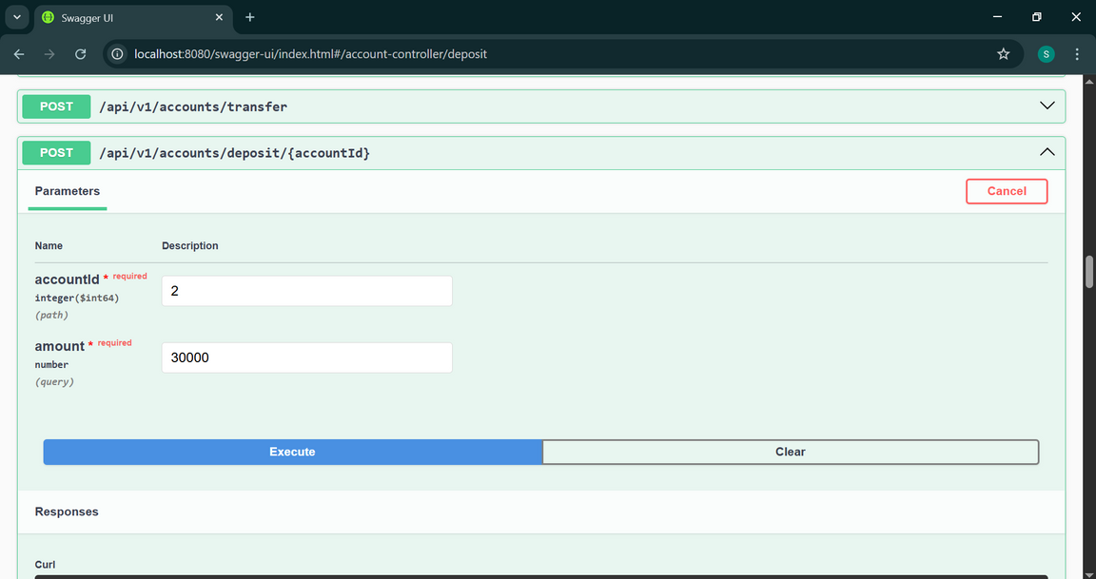
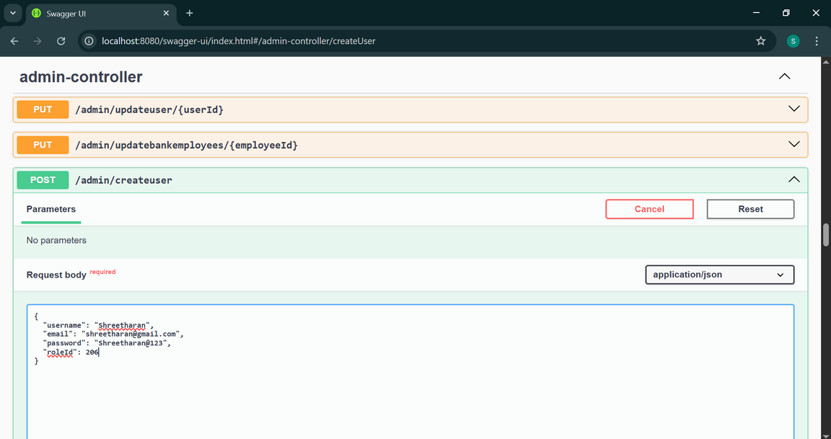
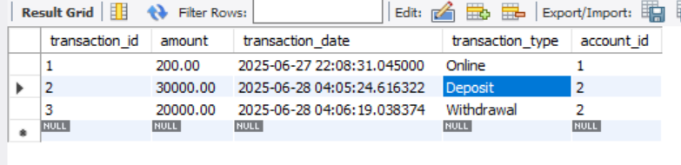
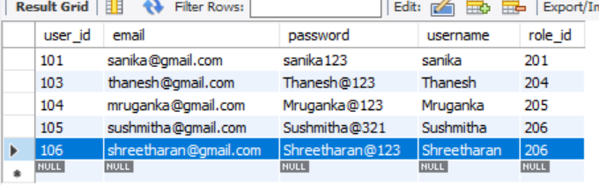
Swagger Output
Account Controller Deposit
Admin Controller Create User

Slide 12

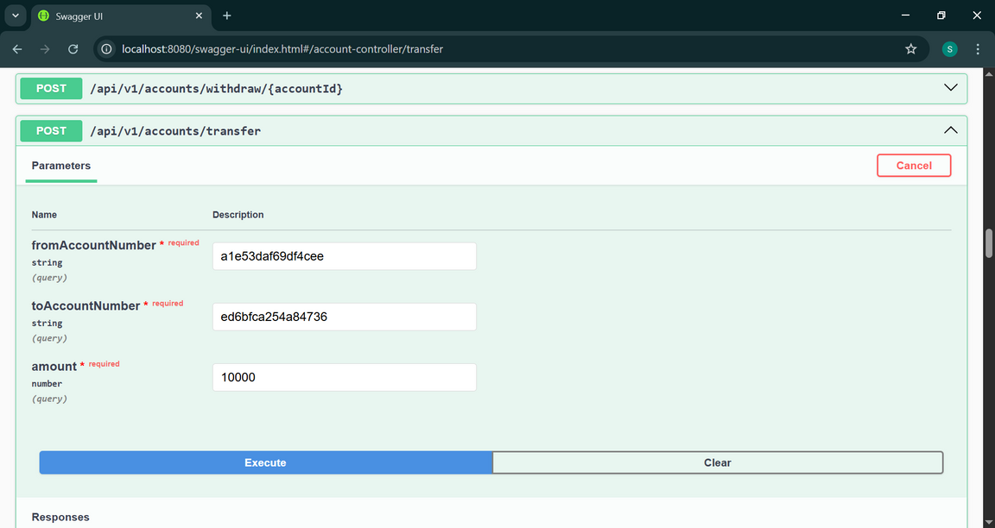
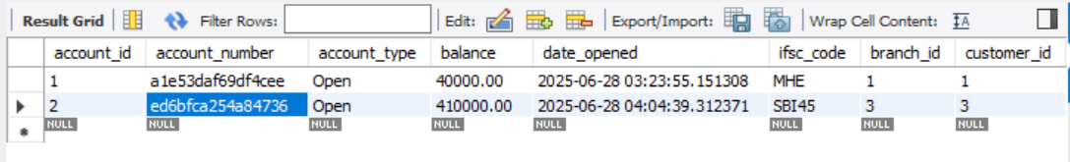
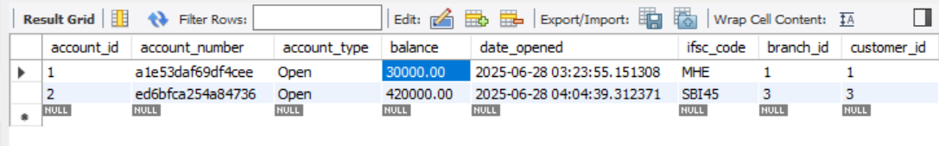
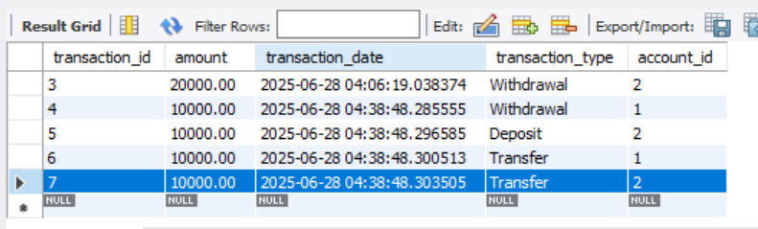
Swagger Output
Account Controller Transfer Amount
Before
Transfer
After
Transfer
Transaction

Slide 13
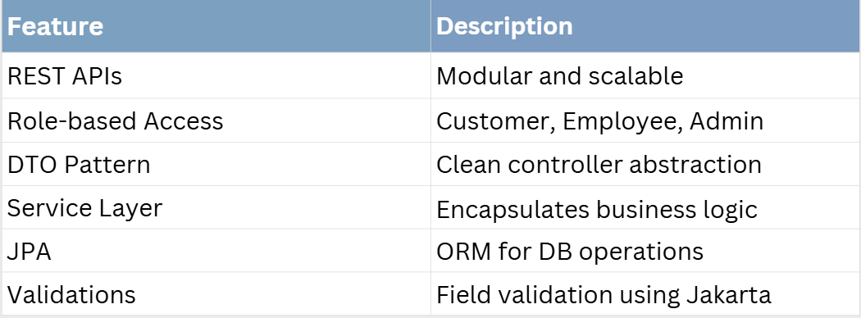
Key Features Implemented

Slide 14
Conclusion
Successfully built a role-based core banking backend.
Covered all key modules and relationships.
Ready to integrate frontend and extend further.
Demo available via Swagger UI + MySQL

